Slide 1

Machine Learning
Session 2

Slide 2




Session 2
Content
Linear regression with one variable review.
cost function review.
gradient descent.
------Break------
pandas & numpy.
Appling with code.
Grow Through

Slide 3
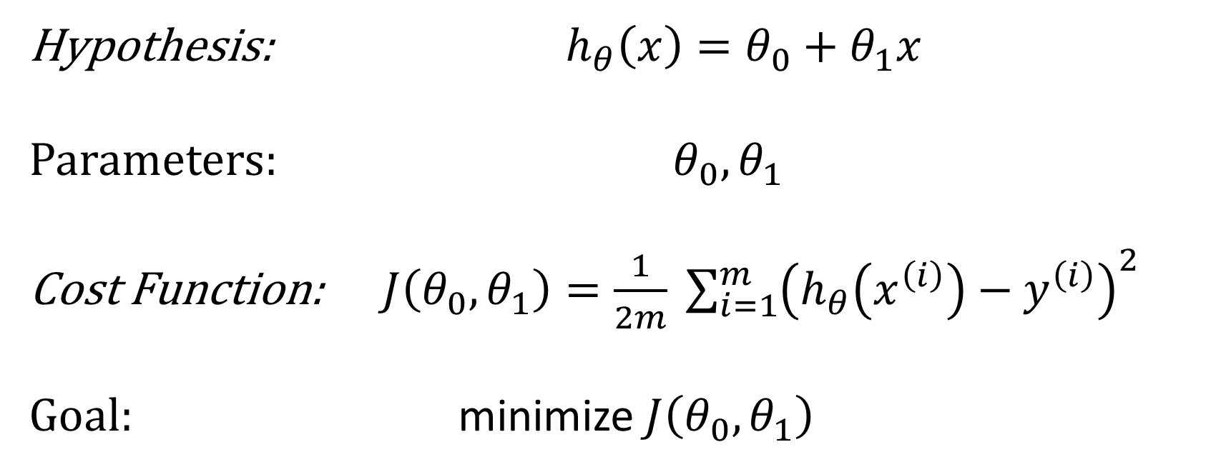
Linear Regression problem with one variable
Hypothesis: $h_{θ}\left(x\right)=θ_{0}+θ_{1}x$
Parameters: $θ_{0},θ_{1}$
Cost Function: $J\left(θ_{0},θ_{1}\right)=\frac{1}{2m} \sum_{i=1}^{m}{{\left(h_{θ}\left(x^{\left(i\right)}\right)−y^{\left(i\right)}\right)}^{2}}$
Goal: minimize $J\left(θ_{0},θ_{1}\right)$
Grow Through

Slide 4
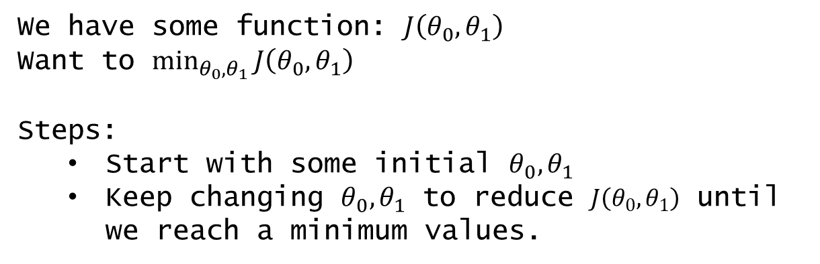
Session 2
Gradient descent
Gradient descent is a first-order iterative optimization algorithm for finding a local minimum of a differentiable function.
We have some function: $J\left(θ_{0},θ_{1}\right)$
Want to $\min_{θ_{0},θ_{1}}{J\left(θ_{0},θ_{1}\right)}$
Steps:
Start with some initial $θ_{0},θ_{1}$
Keep changing $θ_{0},θ_{1}$ to reduce $J\left(θ_{0},θ_{1}\right)$ until we reach a minimum values.
Grow Through

Slide 5
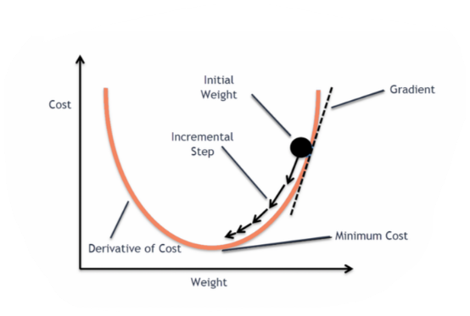
Session 2
Gradient descent
Grow Through

Slide 6
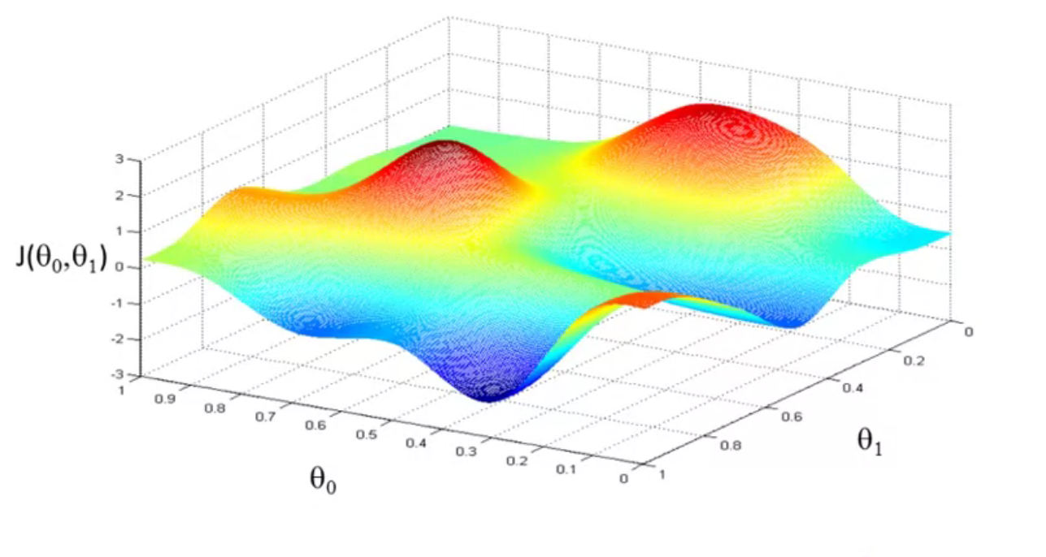
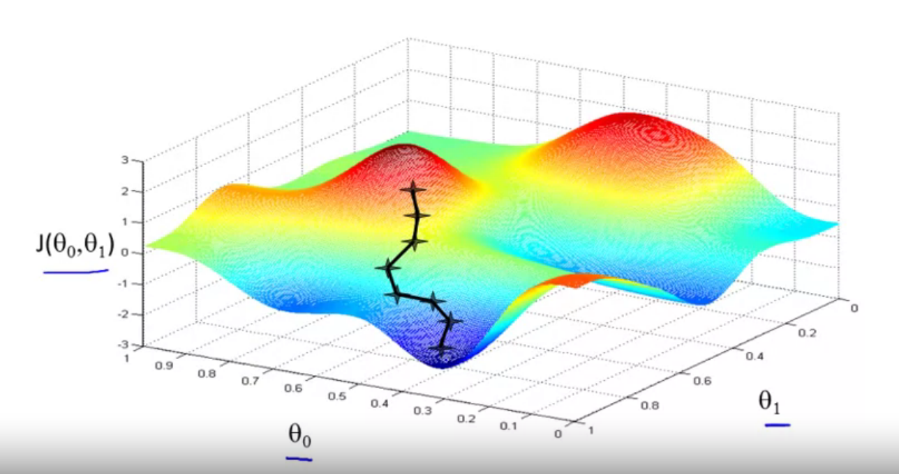
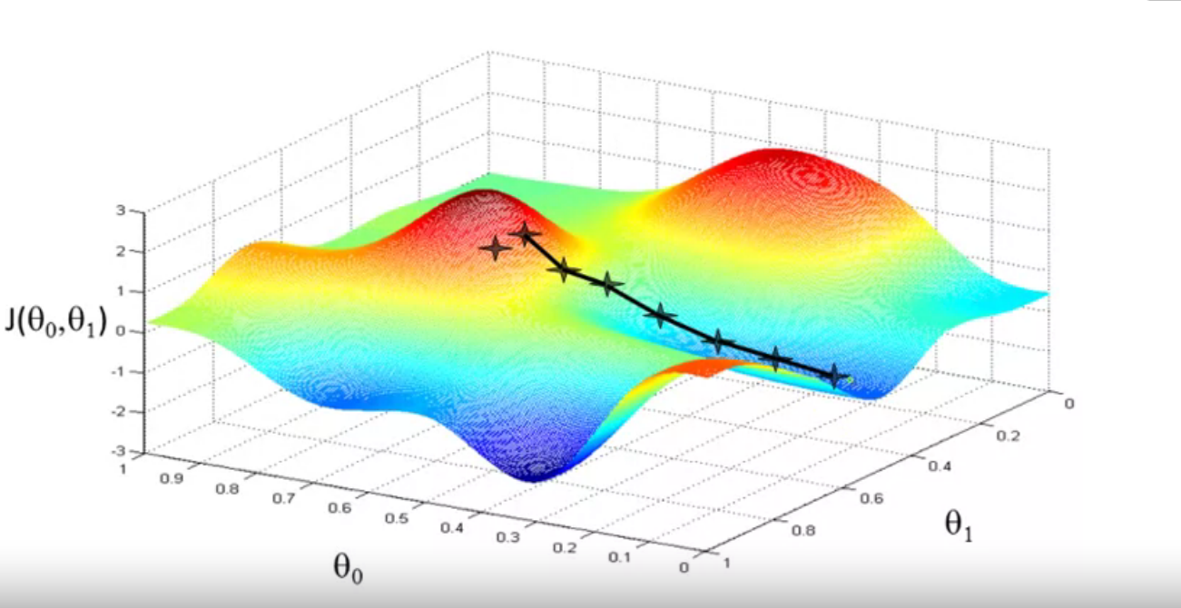
Session 2
Gradient descent
We start with an initial value then we keep changing until we reach a local minimum.
Local minimum
Grow Through

Slide 7
Session 2
Gradient descent
Grow Through

Slide 8
Goodbye
Grow Through

